Slide 1


Defining Classes
Chapter 14.2. from properties to the end
Team 35:
Mariela Kassovska
Ivo Krastev
Krassimir Dimitrof
Mihail Kalchev
Kancho Kanchev

Slide 2
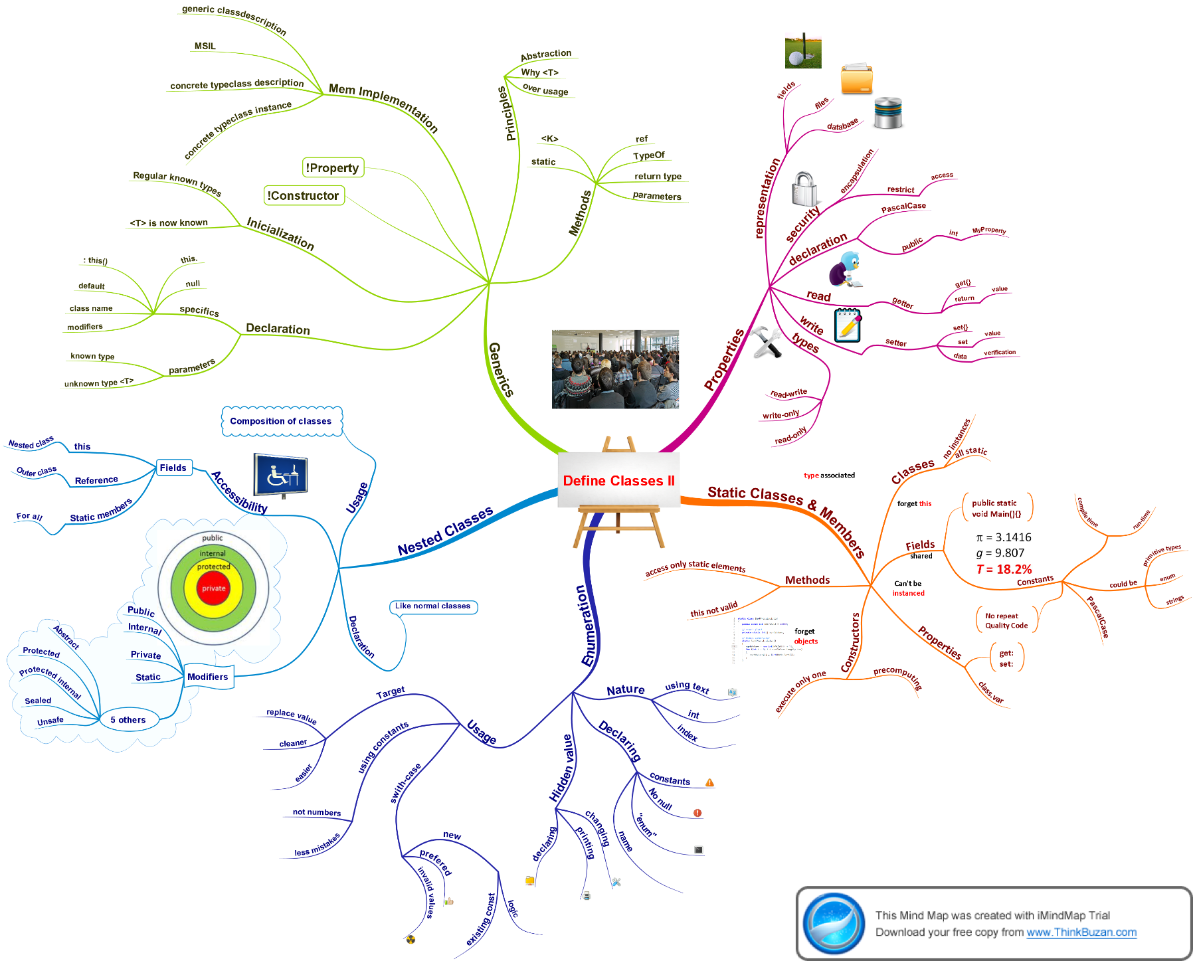
The project

Slide 3
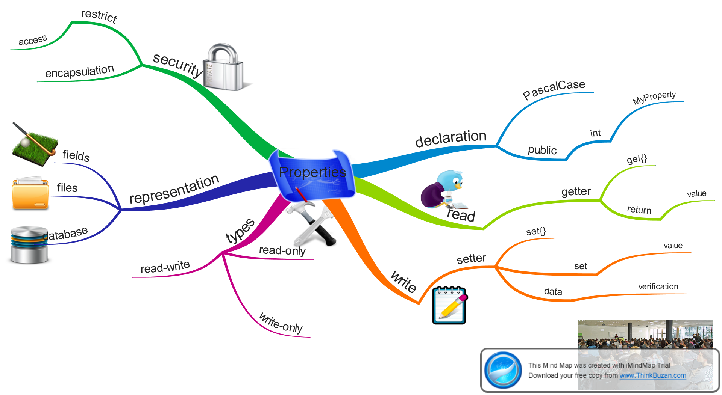
Properties
Mariela Kassovska

Slide 4
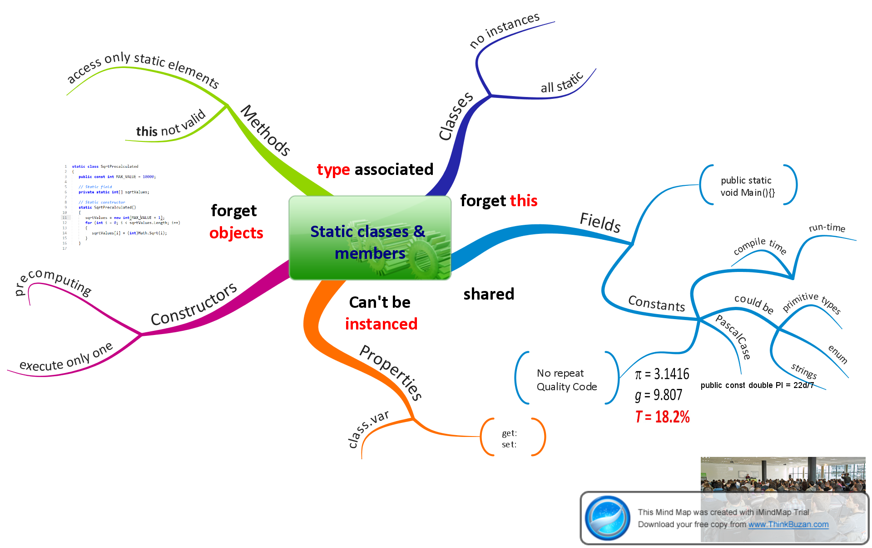
Static classes and members
Krassimir Dimitrof

Slide 5
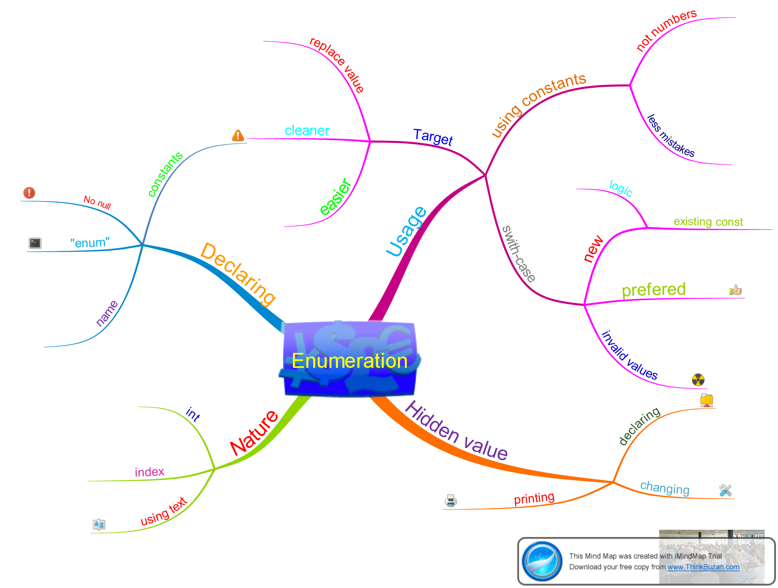
Enumeration
Mihail Kalchev

Slide 6
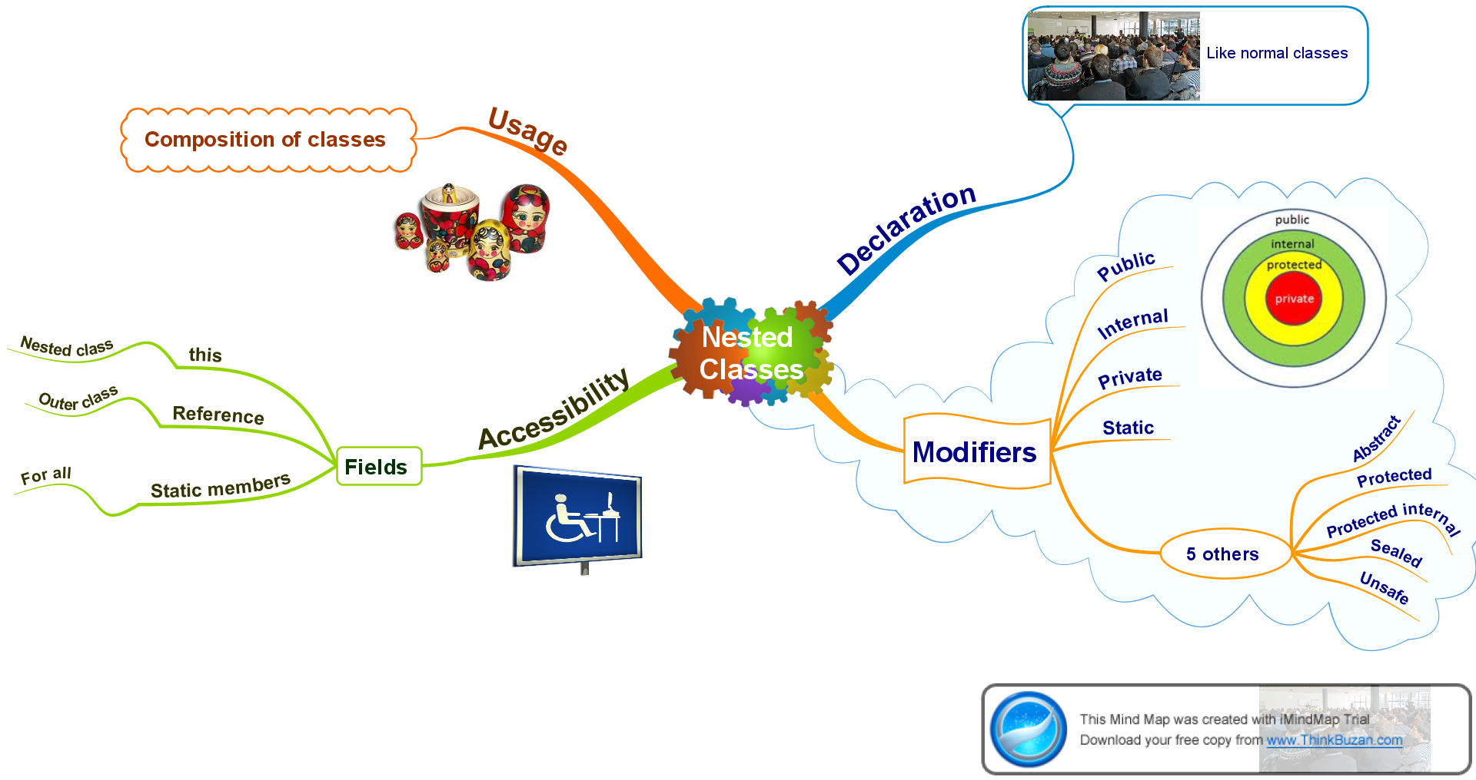
Nested classes
Kancho Kanchev

Slide 7
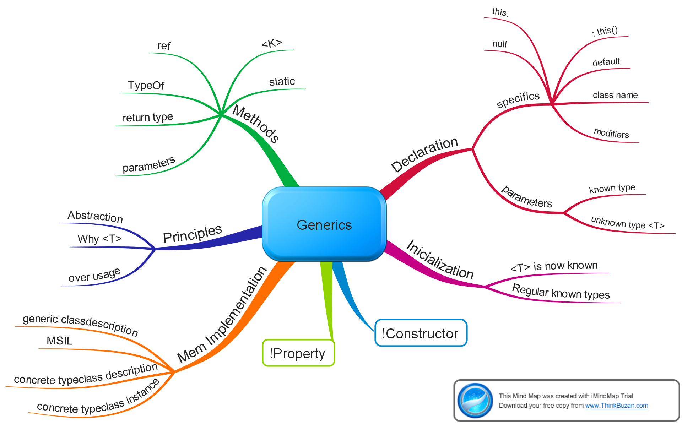
Generics
Ivo Krastev

Slide 8
Other
references:
http://www.thinkbuzan.com/bg/
http://www.introprogramming.info/intro-csharp-book/
http://telerikacademy.com/

Slide 9
http://academy.Telerik.com

Slide 10
Thank You !

